Slide 1
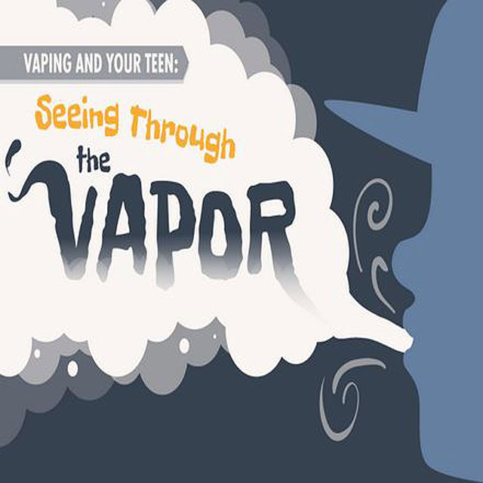

Slide 2
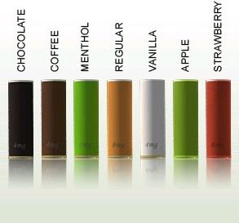
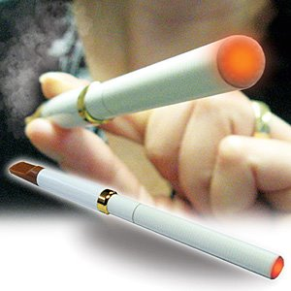
E-Cigarette
Designed to look, feels and smokes just like a real cigarette
Claims to have none of the harmful substances found in real cigarettes.
Emits a virtually odorless vapor
Cost savings- I cartridge = 1-3 packs of Cigarettes. Potential savings of anywhere from $3000 to $5000 per year.
Flavored Cartridges

Slide 3
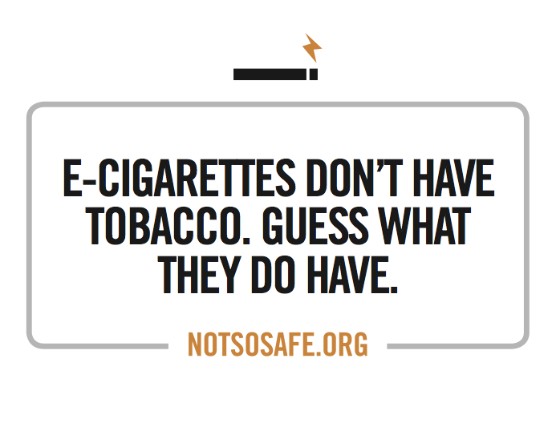

Slide 4
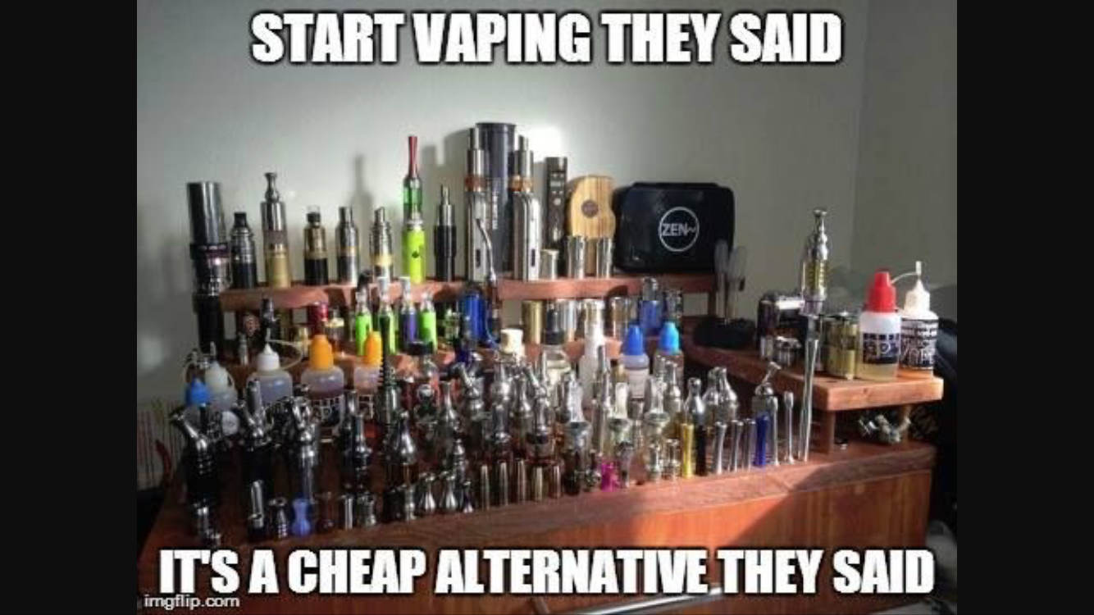

Slide 5
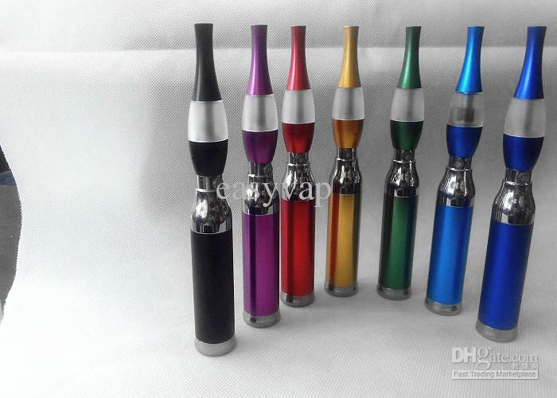
What is an e-cigarette?

Slide 6
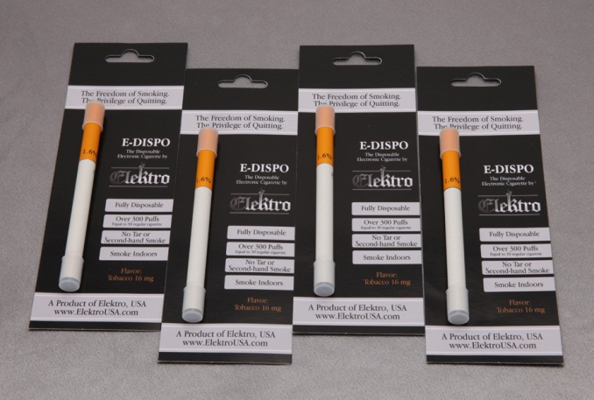
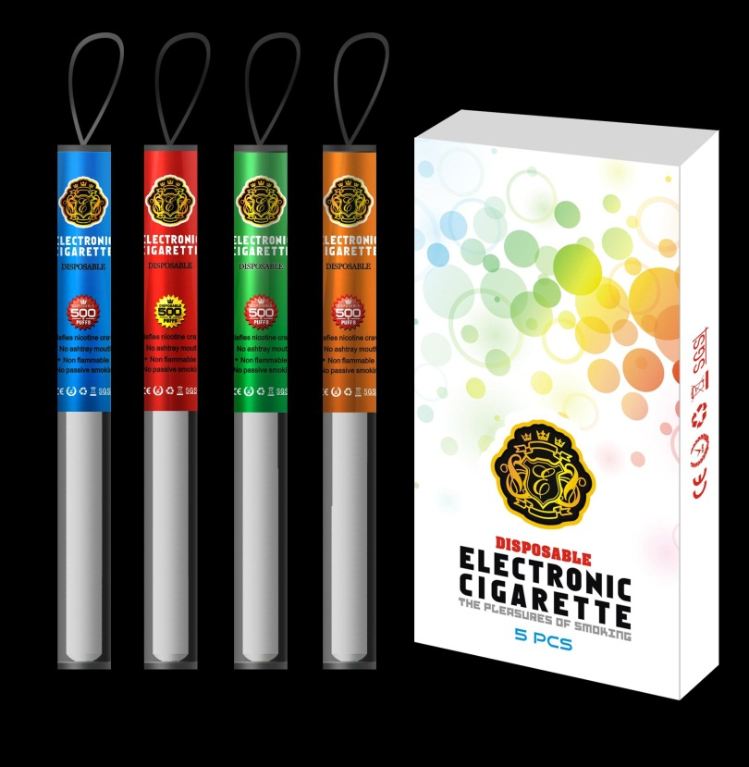
Disposable e-cigarettes
1 e-dispo = 30 cigarettes

Slide 7

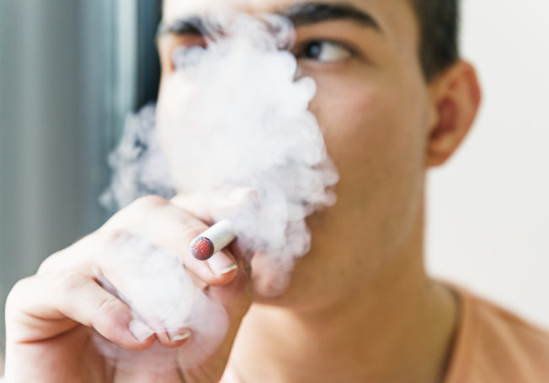
1 out of 5 of middle school students who have smoked have never held a “cigarette”

Slide 10
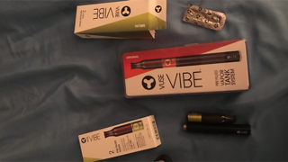

Slide 12
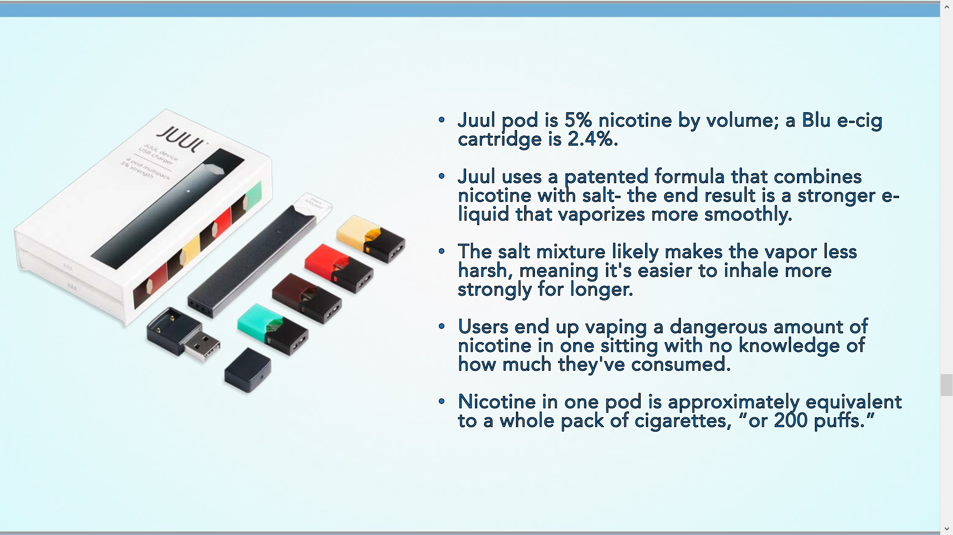

Slide 17
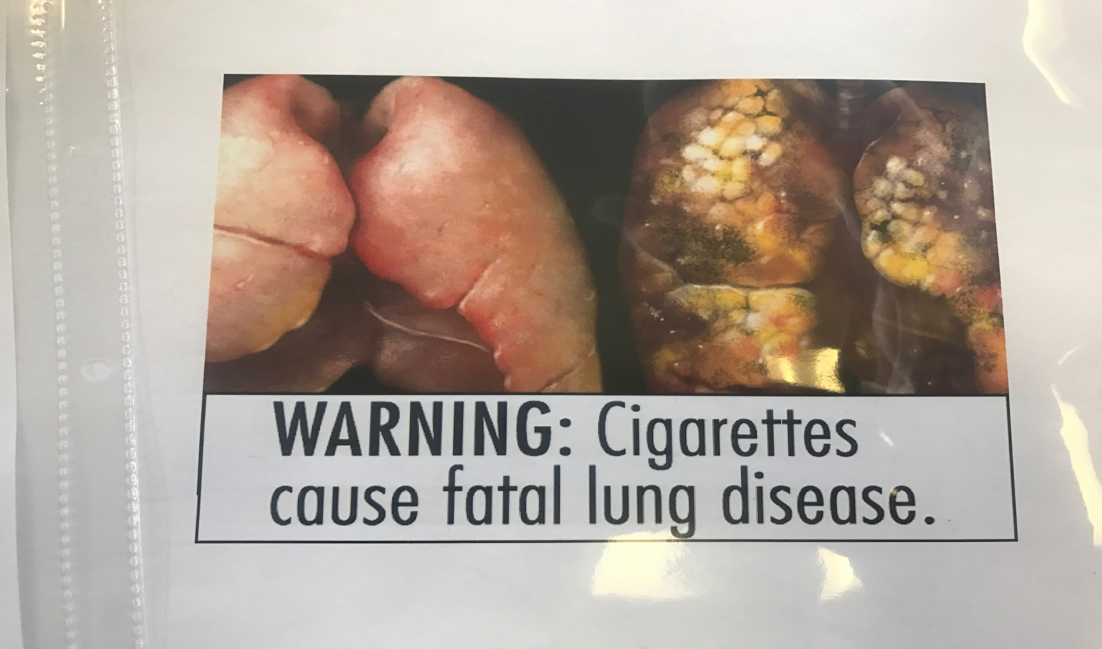

Slide 18
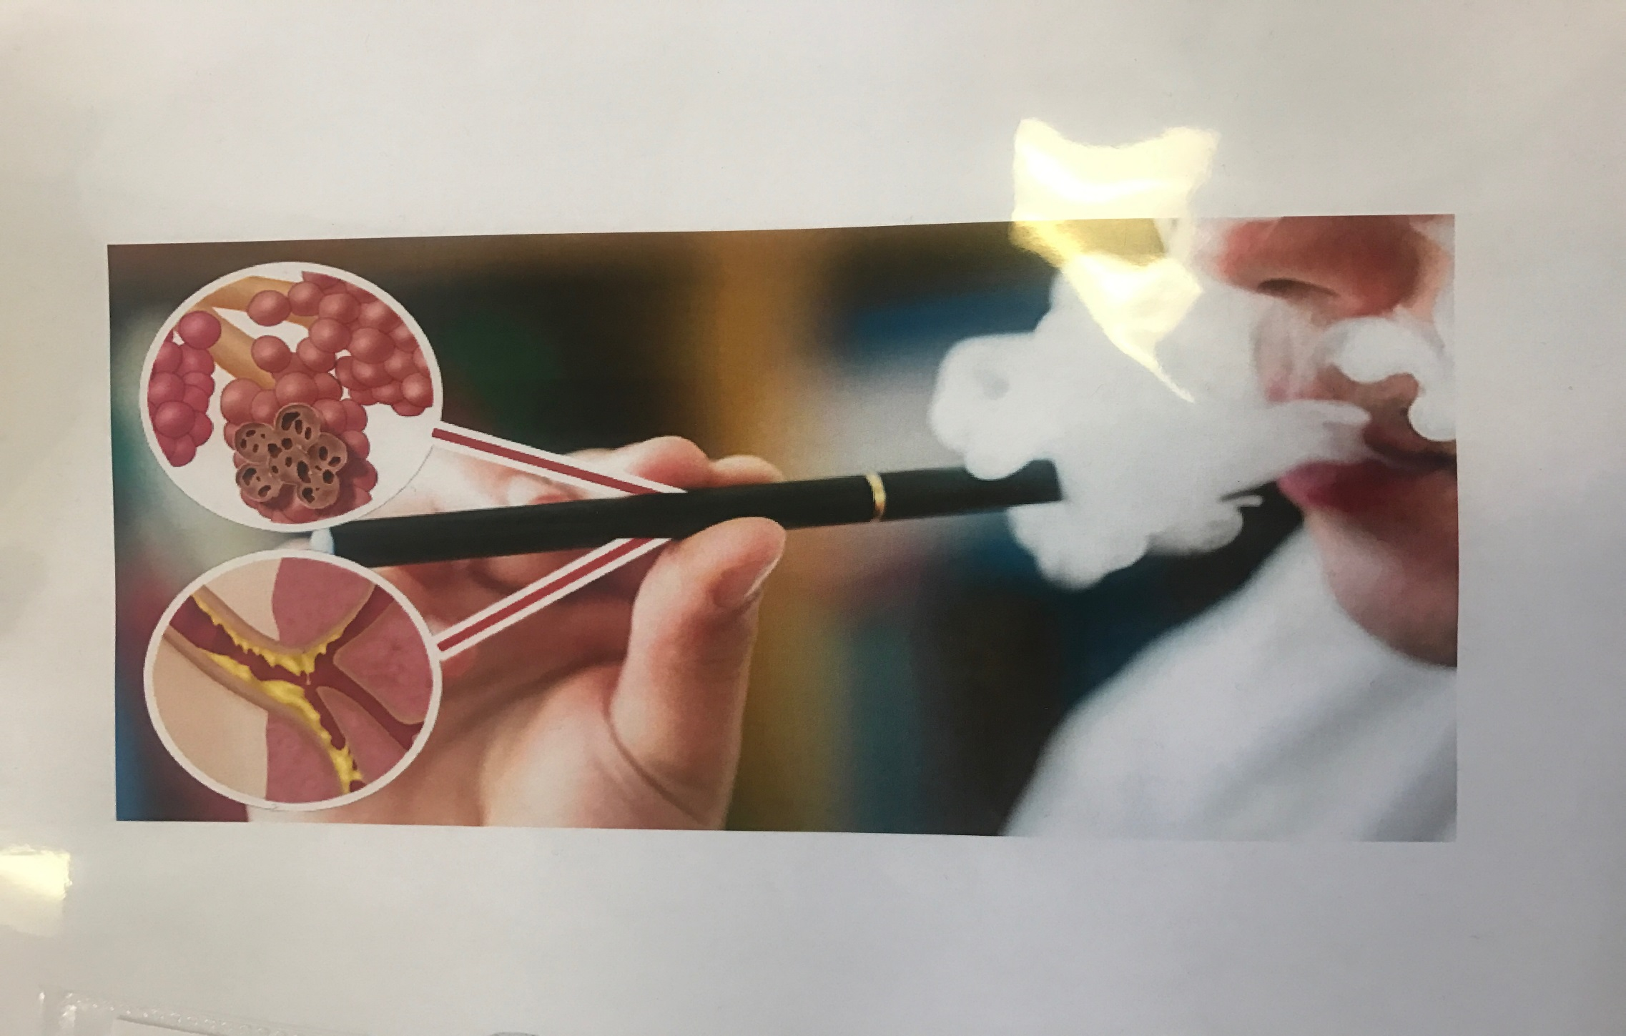

Slide 19
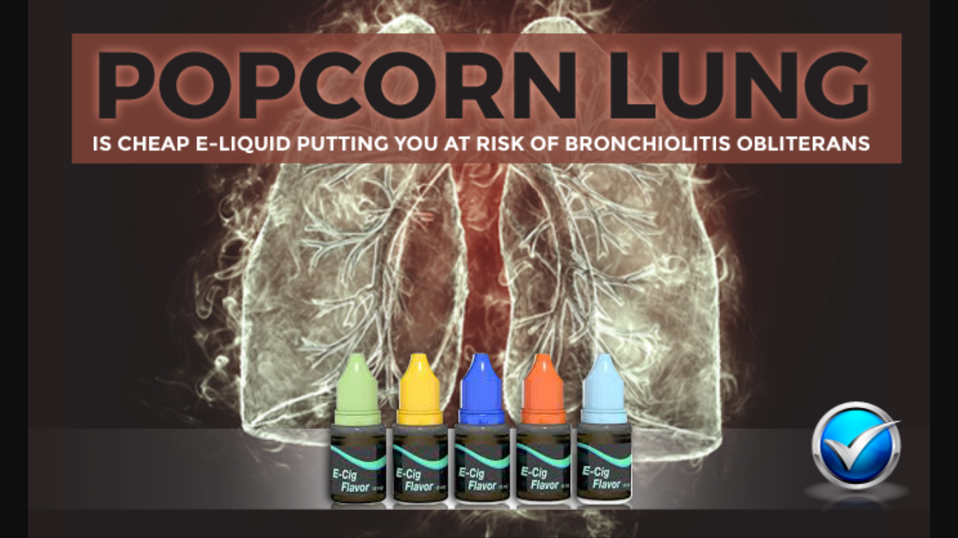

Slide 20
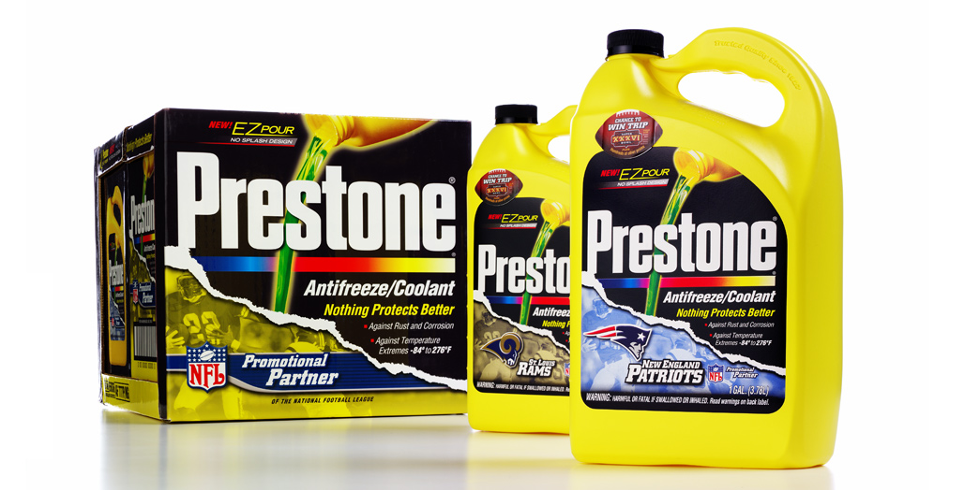
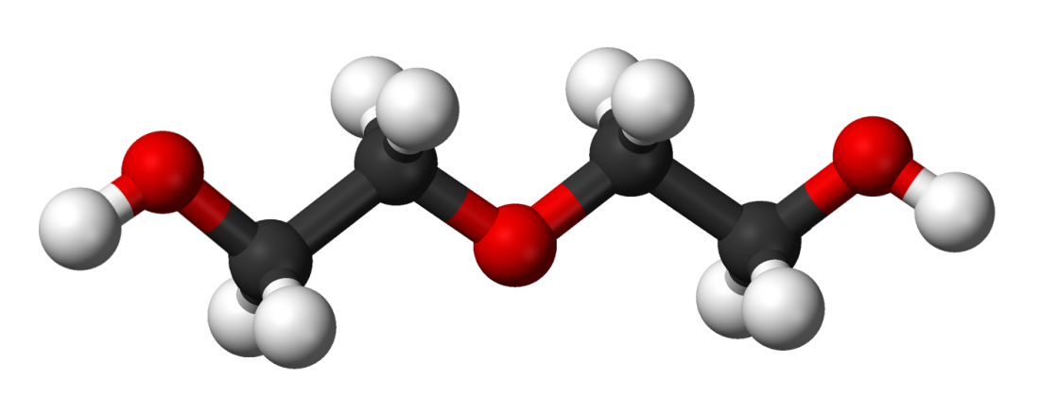
What the FDA reports:
  Diethylene glycol was detected, an ingredient used in antifreeze and toxic to humans and animals.
  Certain tobacco-specific nitrosamines which are human carcinogens were detected in half of the samples tested.
  Tobacco-specific impurities

Slide 21
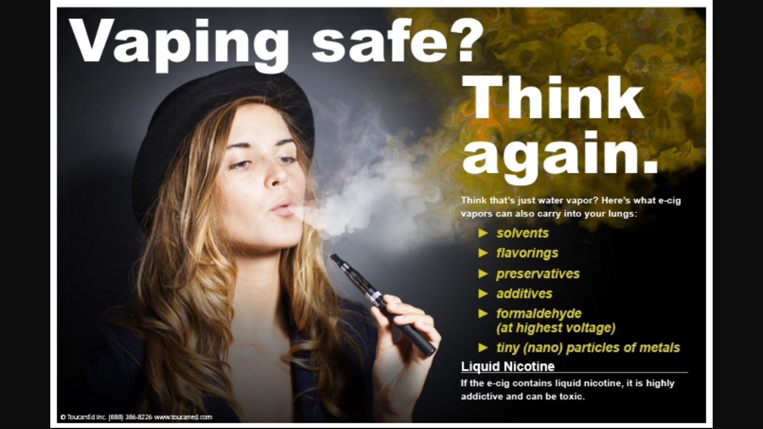

Slide 22
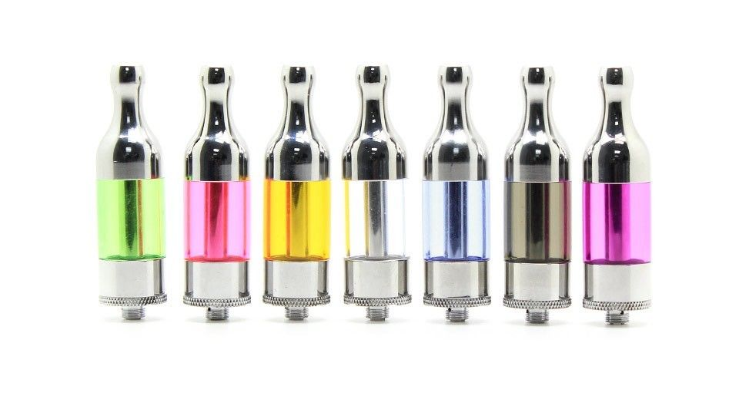
New Risks
Tank systems e-cigs produce formaldehyde, known to be a carcinogen.
E-cigs can make bacterial infections resistant to antibiotics
Deliver high levels of nanoparticles which trigger inflammation and have been
Linked to asthma , stroke, heart disease, and diabetes

Slide 23
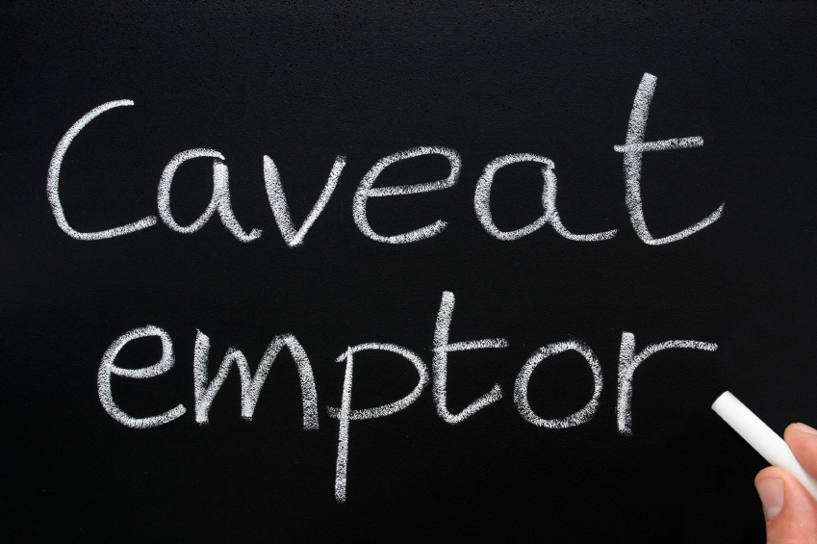
New Study:
  25% of refill liquids tested independently show discrepancies in nicotine levels that range from 92% less to over 103% more than stated
  The “nicotine free” options all contained traceable amounts of nicotine

Slide 25
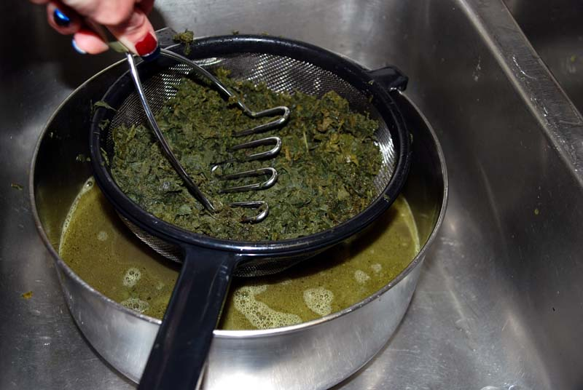
Liquid Marijauna
Sells for$120 for 16 ounces;
Very little smell
5 times as much THC in bloodstream
Get 5 times as many "trips" per $$$ as compared to joint/bong smoking
No carcinogens to give you cancer

Slide 26
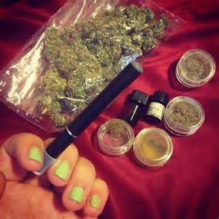
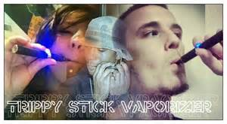
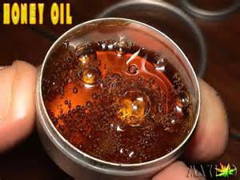
“Trippy Stix” with BHO (Butane Hash Oil)
•Portable Vaporizer that burns Hash oil
••Hash oil also called honey or wax, is the THC oil that is stripped from the leaves of a marijuana plant, usually by soaking in butane and then extracted by vacuum or burning off, which results in a resin
••Strong psychedelic effect and used in very small doses

Slide 27
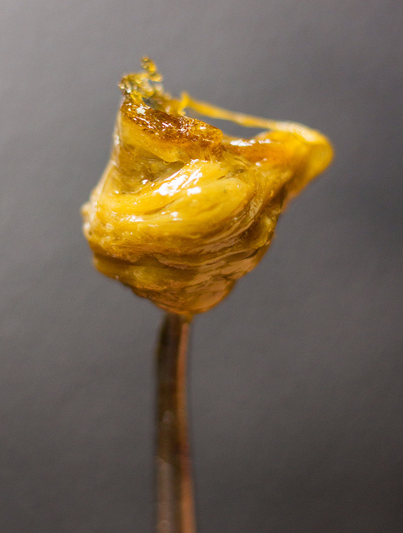
Dabs are concentrated doses of cannabis that are made by extracting THC and other cannabinoids using a solvent like butane or carbon dioxide, resulting in sticky oils also commonly referred to as wax, shatter, budder, and butane hash oil (BHO)

Slide 28
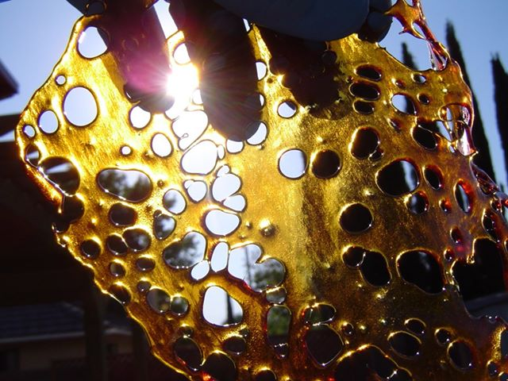
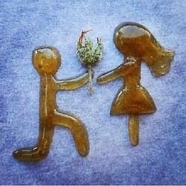

Dabs are concentrated doses of cannabis that are made by extracting THC and other cannabinoids using a solvent like butane or carbon dioxide, resulting in sticky oils also commonly referred to as wax, shatter, budder, and butane hash oil (BHO)

Slide 29
For Additional Information,
Marcene Weatherall
817-744-1041
Marcene.Weatherall@kellerisd.net

